Slide 1
Internet Identity,
Safety, & Security
The world is at your fingertips.
Notes:
slides 45 -

Slide 2
Understanding URLs
.com (.commercial -for most businesses)
.net (.network)
.edu (for education)
.org (for non-profit organizations)
Notes:
You learned about URLs in How to Use a Browser. What is a URL? Uniform Resource Identifier. More commonly called a web address.
Most popular top level domains? .com, .org, .net

Slide 3
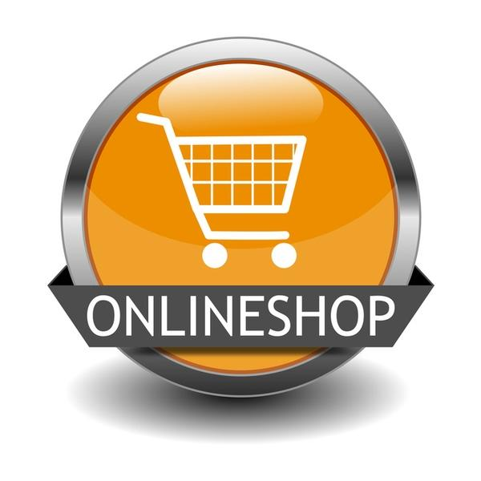
Opening Up the Digital World
shopping
information
entertainment
banking
education

Slide 4
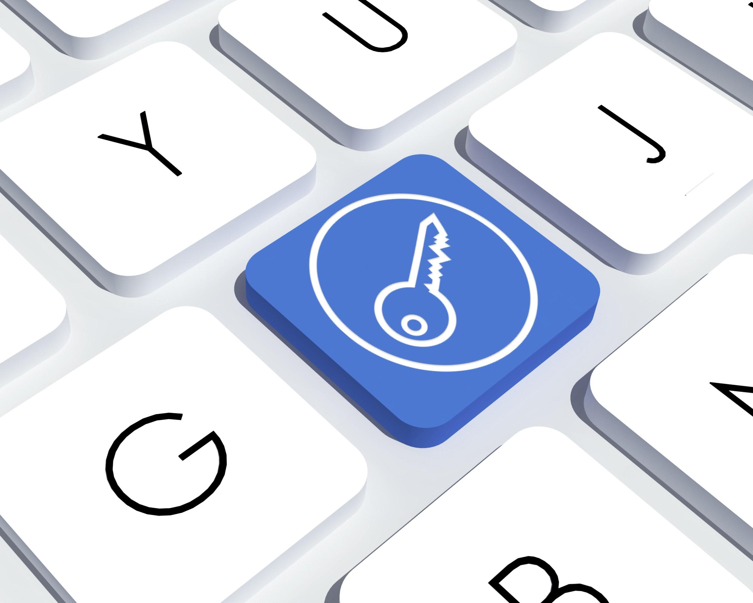
Staying Safe Online
Protect Your Family from Online Identity Theft*
*Someone uses your personal information without your knowledge to commit fraud or theft.
Prevention Tips:
Create strong passwords and use different passwords for different sites - keep them private.
When creating passwords, don't use information that could be easily linked to you (like your birth date, Social Security number, phone number, or the names of pets or hobbies).
Don't reply to e-mail or pop-up messages that requests you update or provide personal information.
Remind your children not to give private information online.

Slide 5
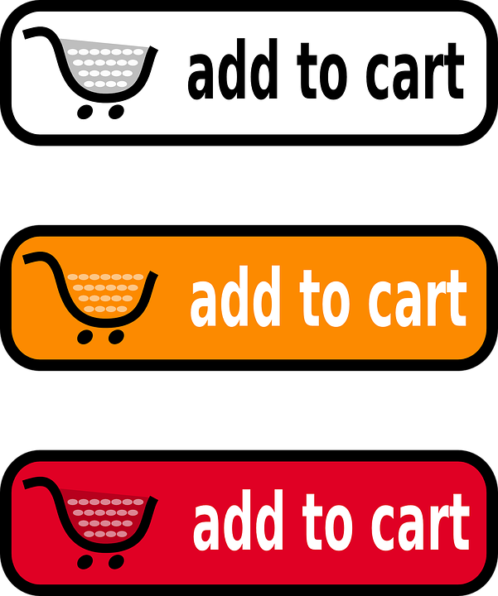
Safe Online Shopping
Type web addresses carefully and only use secure, known sites to shop.
https : the “s” means a secure site.
Never give anyone your credit card information over email.
Protect your personal information.
Online stores don’t need your social security number or your birthday.
Choose one credit card or a prepaid credit card for online use only.
Notes:
are any of you shopping online? we are in no way promoting that you shop online!

Slide 6
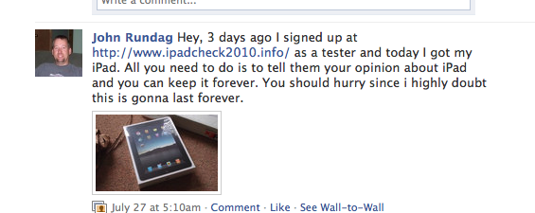
How Viruses & Spyware Spread
User clicks on link in an email, email attachment, or downloadable file on a website or on a social network. The link takes user to a website that attacks browser and forces virus or spyware
Prevention Tip: Don’t click on suspicious links, pop ups, or ads offering you anything for free, even if it looks like it comes from a friend.
fREE IPAD!!!!
Notes:
Have you heard the phrase there’s no such thing as a free lunch? Well, there’s also no such thing as a free iPad. Mention that Chromebooks are more secure than a PC or laptop but that it’s important to understand how easy it is to inadvertently click on something malicious.
Have you ever received a similar message? Maybe through email?
Email and networking profiles get hijacked.

Slide 7
Your Digital Footprint
Dos Tipos de Estúpido
Two Kinds of Stupid
Maintaining a positive online reputation is emphasized by SAUSD. It is important since it can affect students’ college and career opportunities.
The video above is an example of teaching materials used in our classrooms.
Notes:
Click the hyperlink to show the video (3:03 minutes). Screen will open in Netsmartz - expand to full screen.

Slide 8
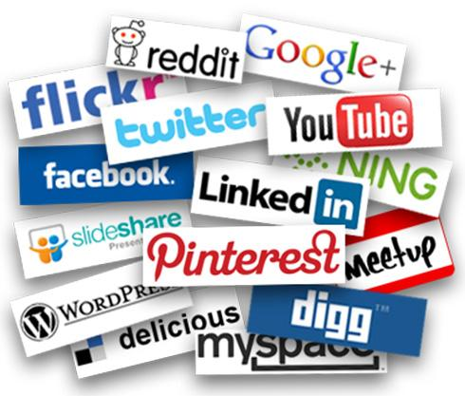
Protect Your Online Identity
Potential employers often look at Facebook pages.
Private information is no longer, by default, private. If you want information to be private, you must take steps to make it so.
Digital content is easily forwarded and re-posted.
Your online reputation has offline implications.
Notes:
A

Slide 9
Notes:
End of class 2.. Ask if there are any questions or comments.

